Slide 1














NREGA Project Analysis Using Power BI
Presented by Vijaya Laxmi

Slide 2

ABSTRACT
1
This project delves into the analysis of data related to the National Rural Employment Guarantee Act (NREGA), a transformative government scheme aimed at providing rural households with guaranteed wage employment opportunities. The dataset used for this analysis encompasses a wide range of parameters, including the number of job cards issued, the workforce engaged, budget allocation, work completion statistics, and much more. Through the application of data analytics techniques, we aim to gain valuable insights into the implementation and impact of NREGA across different states and districts in India.

Slide 3
PROBLEM STATEMENT
4
NREGA is a vital initiative to alleviate rural unemployment and poverty. This project seeks to address several key questions and challenges associated with NREGA:
How effective is NREGA in providing employment opportunities to rural households?
Are there regional disparities in the implementation and outcomes of the scheme?
What is the utilization of the allocated budget, and how does it correlate with employment generation?

Slide 4
4
PROBLEM STATEMENT CONTD...
What are the key factors contributing to the completion of NREGA works, and are there any roadblocks to its success?
Can data-driven insights guide policymakers and administrators in optimizing the scheme's impact?

Slide 5
DATASET INFORMATION
1
The dataset used for this analysis is sourced from official government records and contains information related to NREGA implementation across various states and districts in India. It comprises 28 columns, encompassing data on job cards, worker details, budget allocation, work completion statistics,
expenditure, and more. This dataset offers a comprehensive view of the progress and challenges faced by the NREGA program.

Slide 6
VARIABLE DESCRIPTION
1
state_name: Name of the Indian state.
district_name: Name of the district within the state.
Total No. of JobCards issued: The total number of job cards issued to rural households.
Total No. of Workers: The total number of workers registered under NREGA.
Total No. of Active Job Cards: The number of active job cards at a given point in time.
Total No. of Active Workers: The number of workers currently engaged in NREGA works.

Slide 7
VARIABLE DESCRIPTION CONTD...
1
SC workers against active workers: The count of Scheduled Caste workers among active workers.
ST workers against active workers: The count of Scheduled Tribe workers among active workers.
Approved Labour Budget: The budget allocated for labor under NREGA.
Persondays of Central Liability so far: The total persondays of employment provided, considering central liability.
SC persondays: Persondays of employment provided to Scheduled Caste workers.
ST persondays: Persondays of employment provided to Scheduled Tribe workers.
Women Persondays: Persondays of employment provided to women.

Slide 8
VARIABLE DESCRIPTION CONTD...
1
Average days of employment provided per Household: The average number of days of employment provided per rural household.
Average Wage rate per day per person(Rs.): The average daily wage rate per NREGA worker in Indian Rupees.
Total No of HHs completed 100 Days of Wage Employment: The number of households completing 100 days of wage employment.
Total Households Worked: The total number of households involved in NREGA works.
Total Individuals Worked: The total number of individuals engaged in NREGA works.
Differently abled persons worked: The count of differently abled persons who participated in NREGA works.

Slide 9
VARIABLE DESCRIPTION CONTD...
1
Number of GPs with NIL exp: The number of Gram Panchayats with zero expenditure.
Total No. of Works Takenup (New+Spill Over): The total number of works initiated, including new projects and spill-over from previous periods.
Number of Ongoing Works: The count of works that are currently in progress.
Number of Completed Works: The count of works that have been successfully completed.
% of NRM Expenditure(Public + Individual): The percentage of expenditure on Natural Resource Management (NRM) projects, including both public and individual contributions.
% of Category B Works: The percentage of expenditure on Category B works.
% of Expenditure on Agriculture & Agriculture Allied Works: The percentage of expenditure on agriculture and allied activities.

Slide 10
VARIABLE DESCRIPTION CONTD...
1
Total Exp(Rs. in Lakhs.): Total expenditure in Indian Rupees (in lakhs).
Wages(Rs. In Lakhs): Expenditure on wages in Indian Rupees (in lakhs).
Material and skilled Wages(Rs. In Lakhs): Expenditure on materials and skilled wages in Indian Rupees (in lakhs).
Total Adm Expenditure (Rs. in Lakhs): Total administrative expenditure in Indian Rupees (in lakhs).

Slide 11
1
Scope of this Project
Data Pre-Processing
Data Cleaning
Exploratory data analysis (EDA) to identify patterns, trends, and disparities
Utilizing data visualization techniques to present key findings effectively

Slide 12

POWER BI
Some of the Advantages of Power BI
Easy to use.
Time-Seizing Models.
Integration utilizing numerous data sources.
Integration of Excel without comparison.
Continuous Updates.
Cost Efficiency.
The capability of available current AI systems.
Additional features for other Microsoft applications.
03 - SOCIAL MEDIA

Slide 13
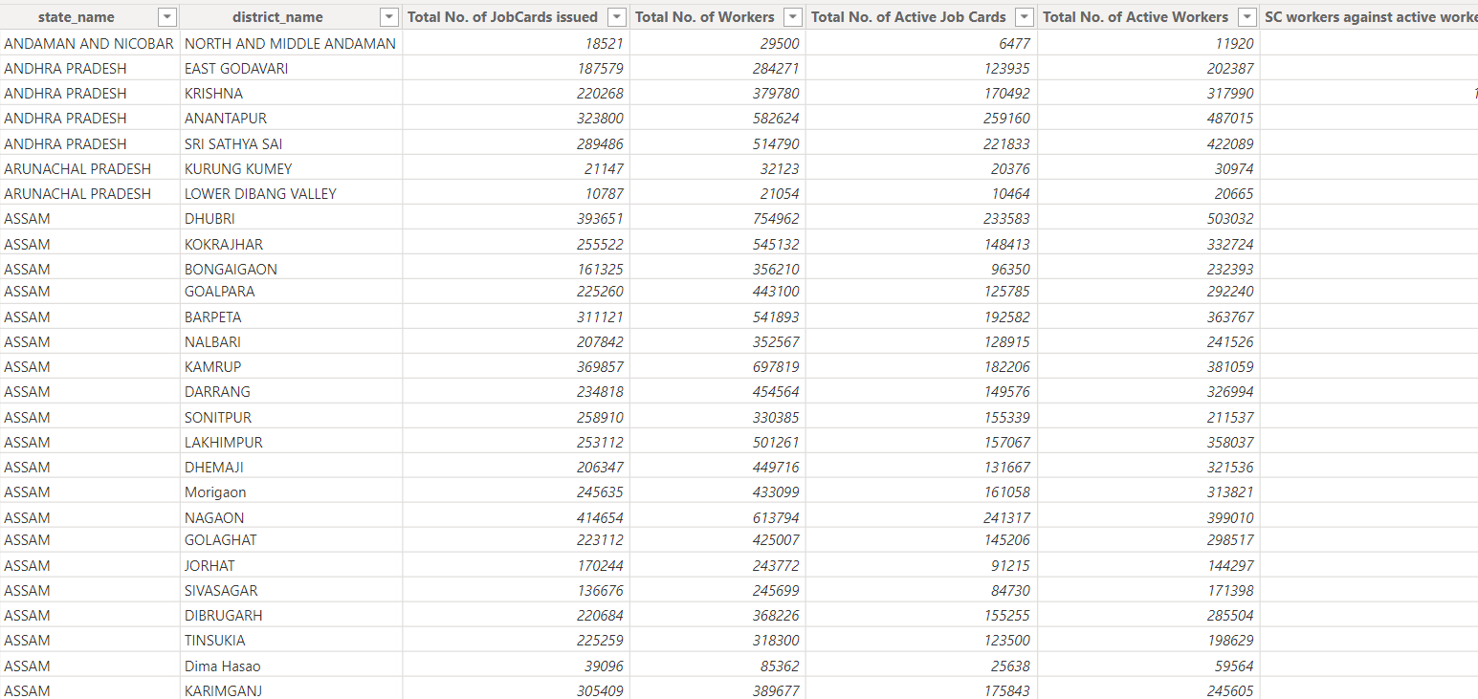
NREGA Dataset

Slide 14
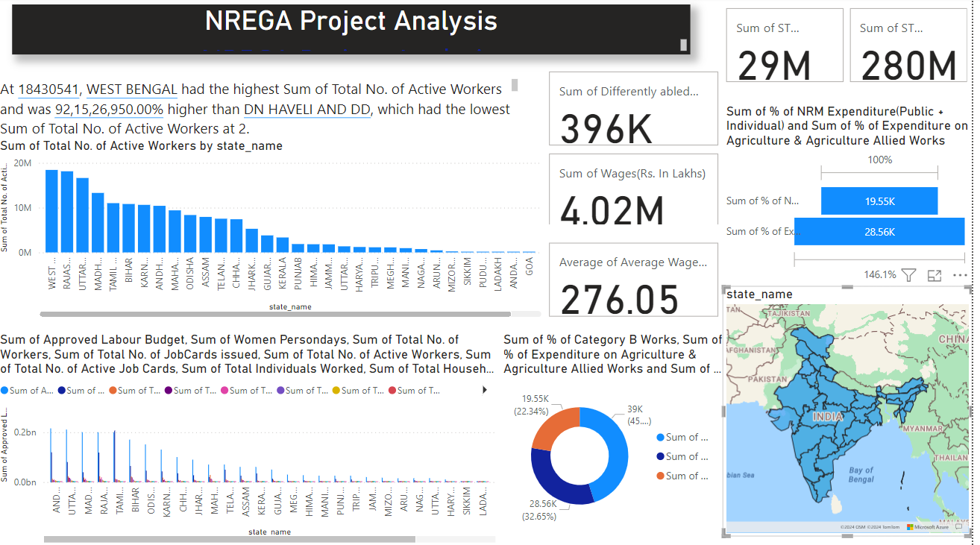

Slide 15
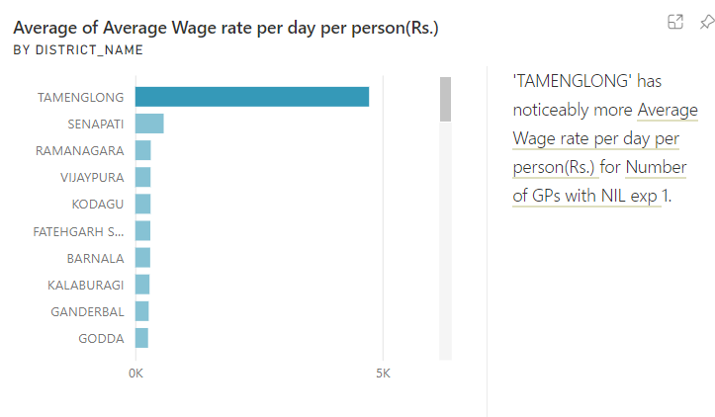
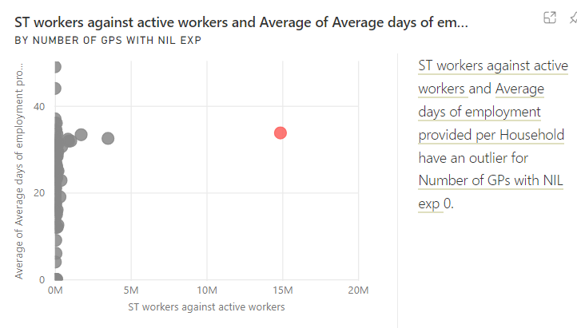

Slide 16
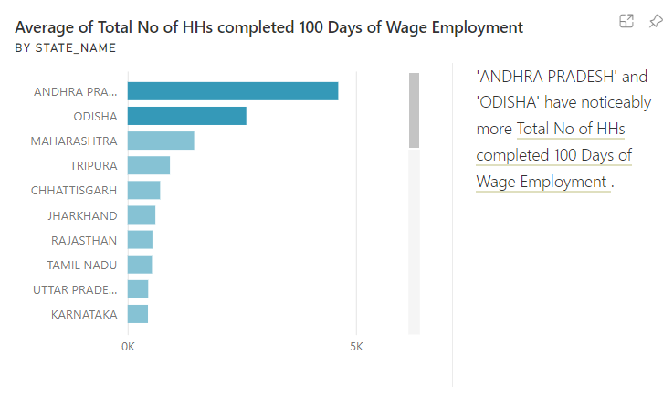
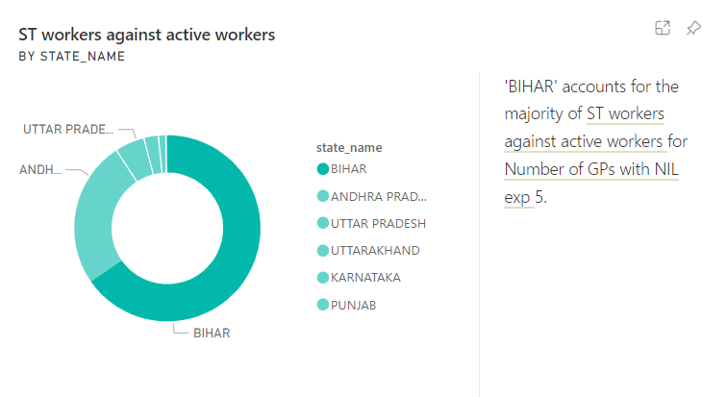

Slide 17
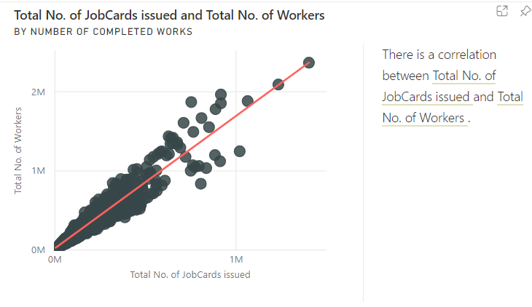
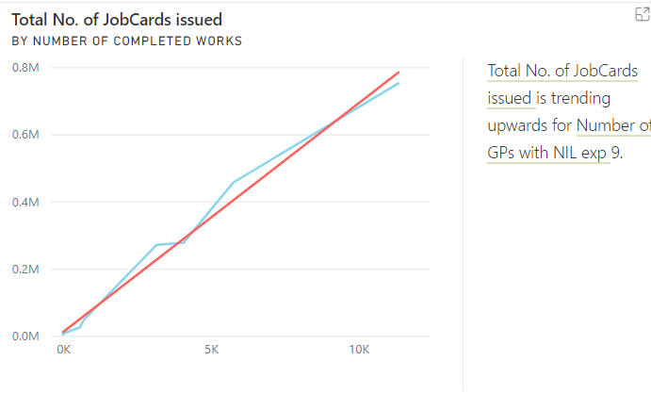

Slide 18
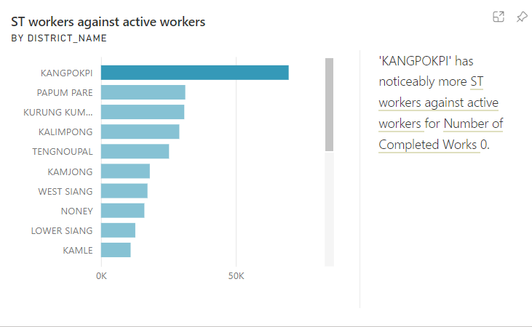
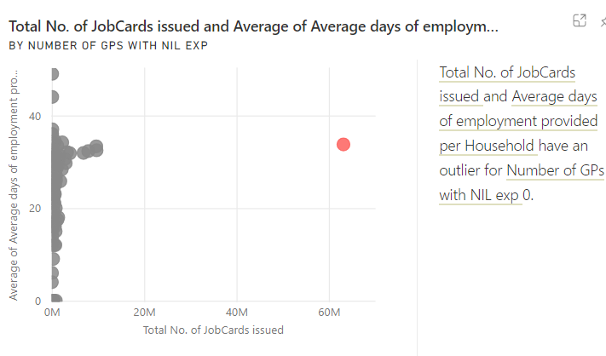

Slide 19
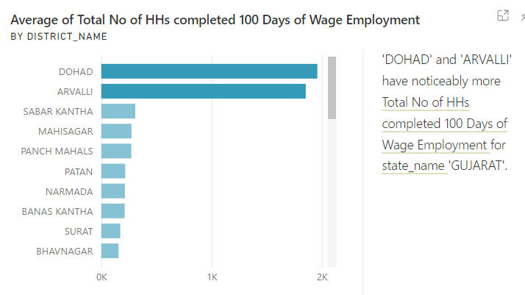
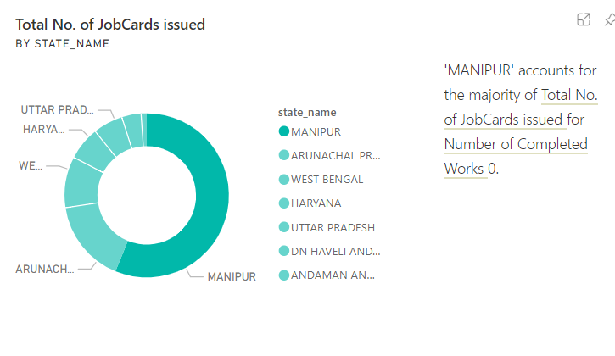

Slide 20
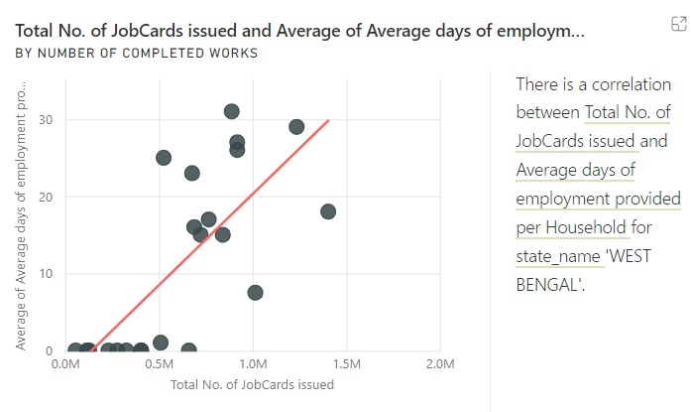
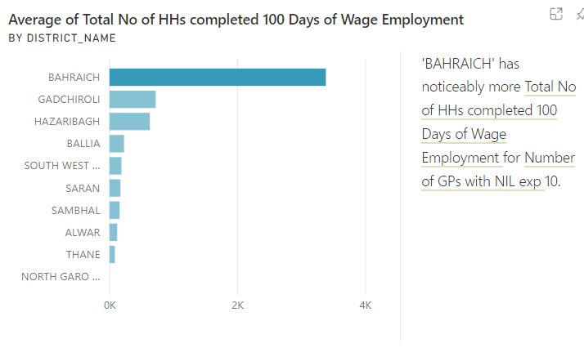

Slide 21
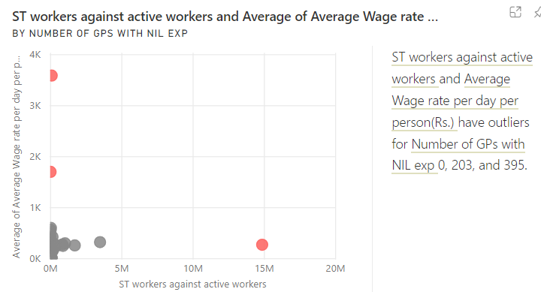
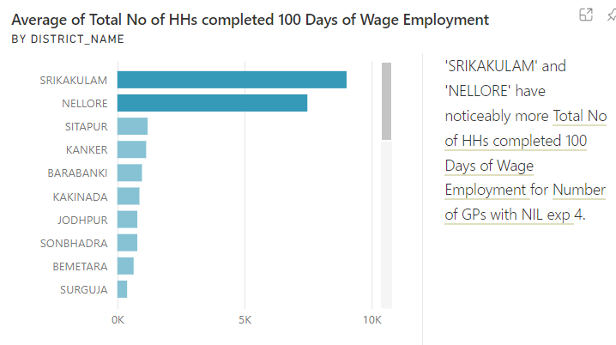

Slide 22
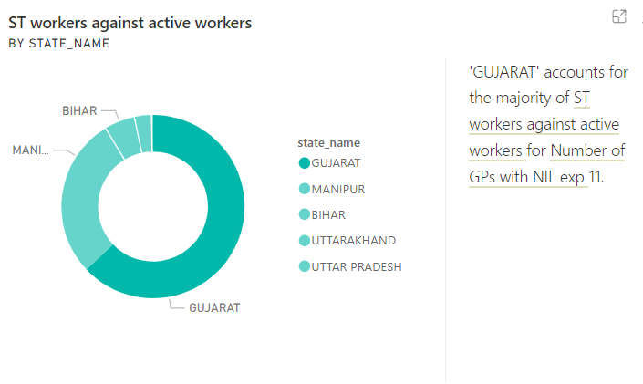
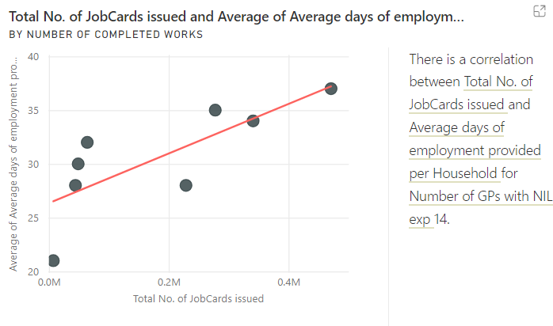

Slide 23
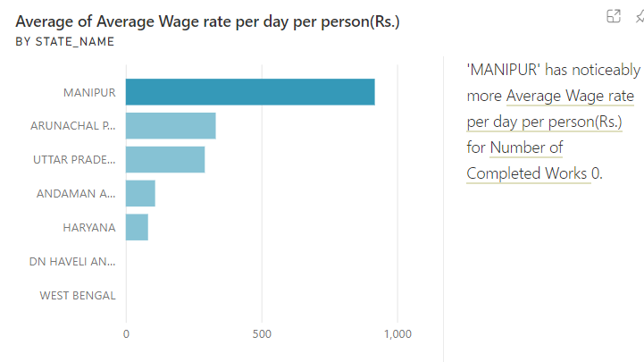
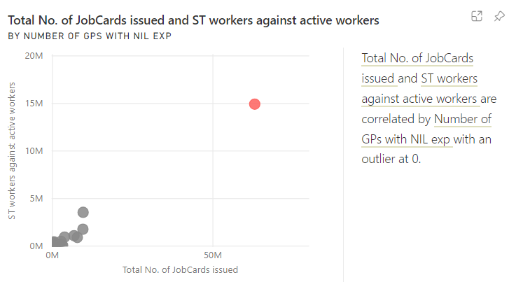

Slide 24
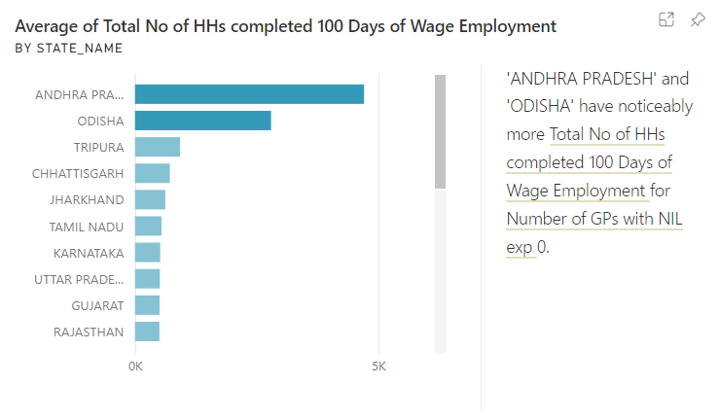
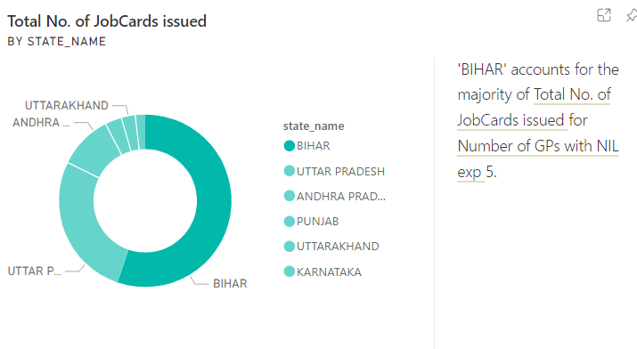

Slide 25
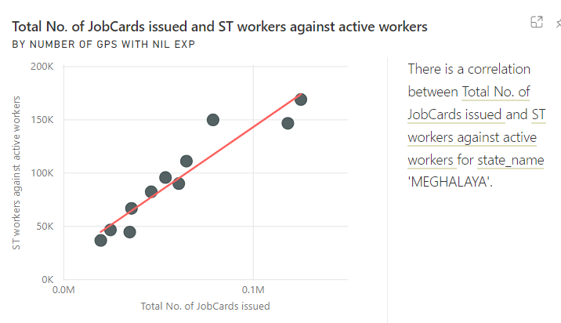
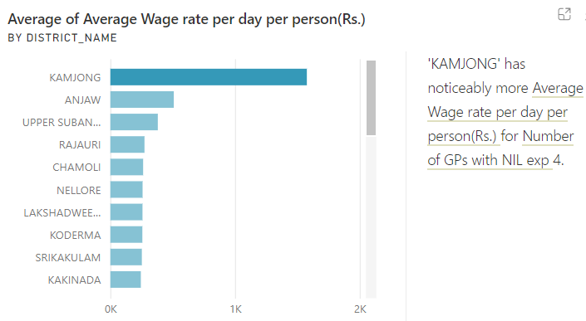

Slide 26
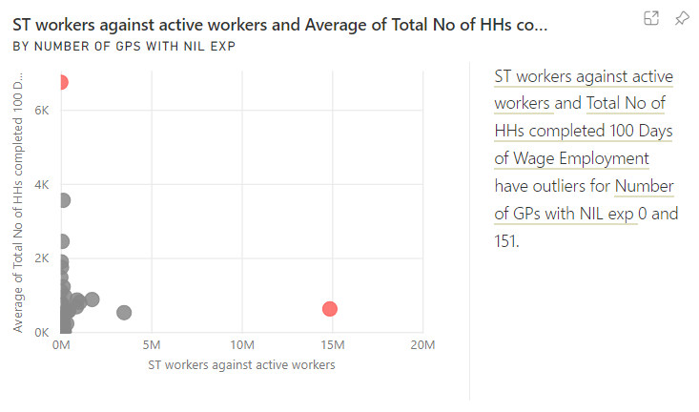
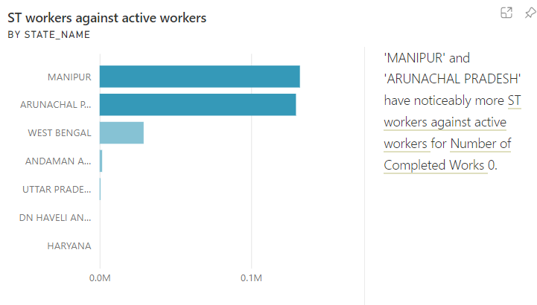

Slide 27
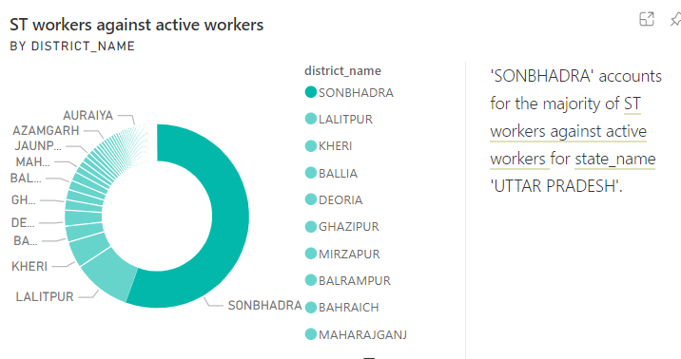
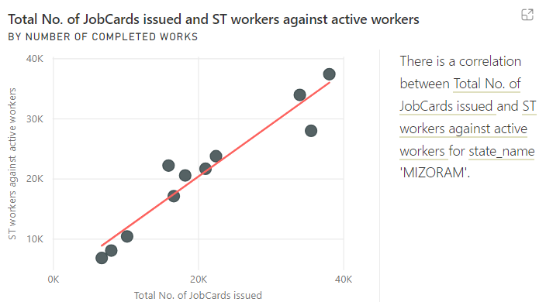

Slide 28
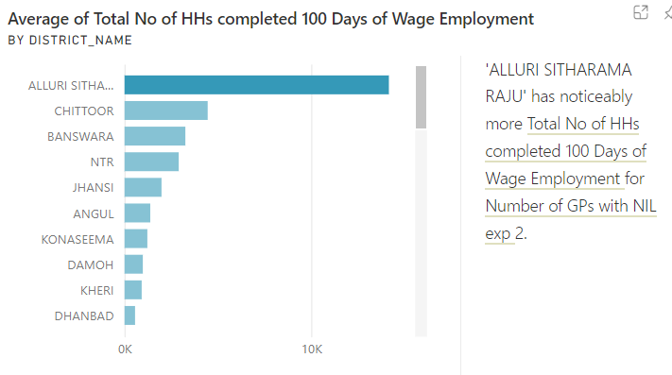
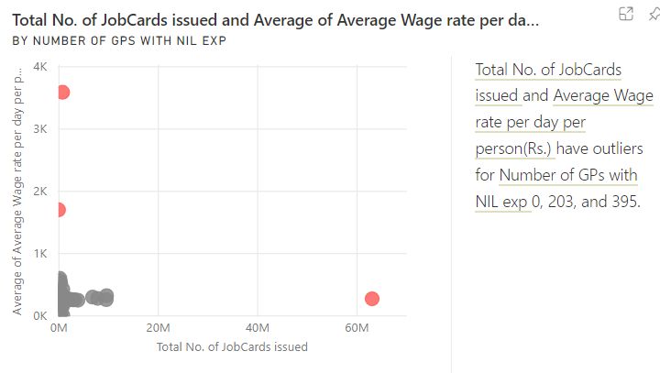

Slide 29
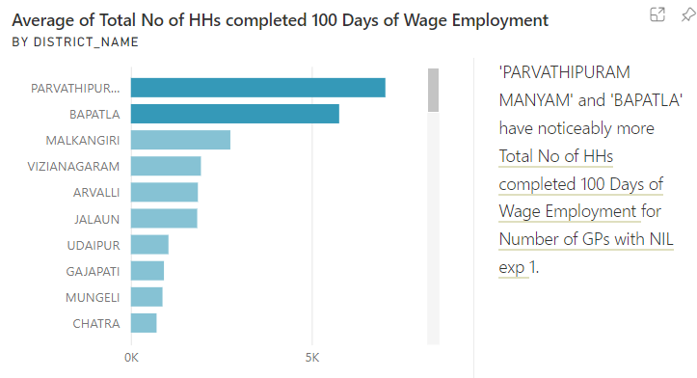
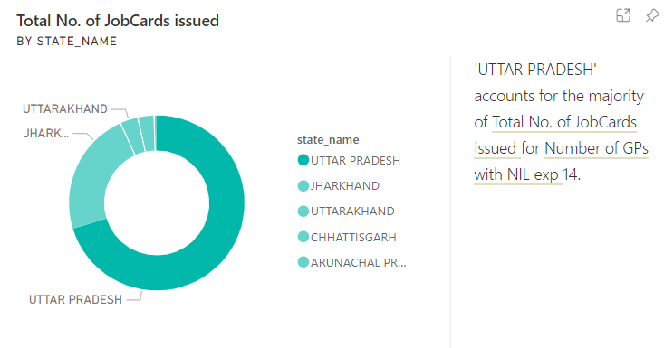

Slide 30
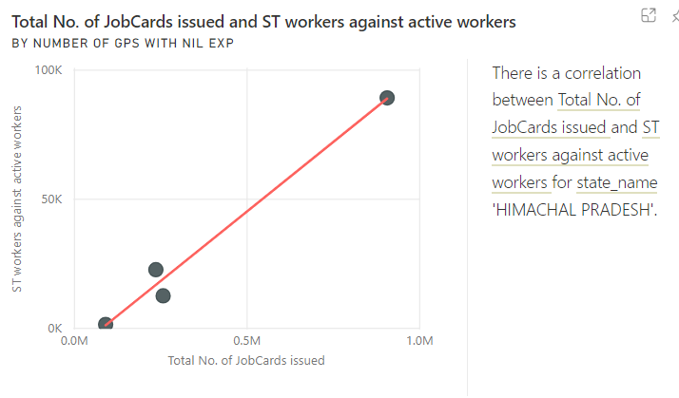
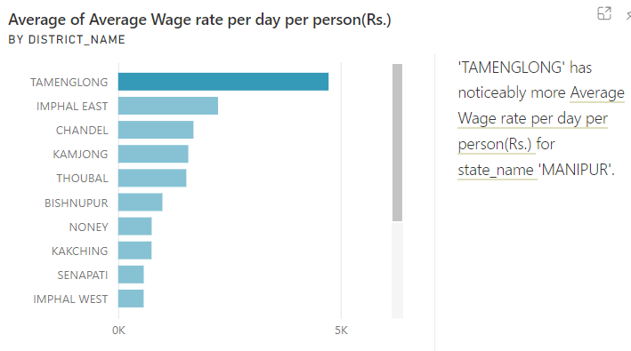

Slide 31
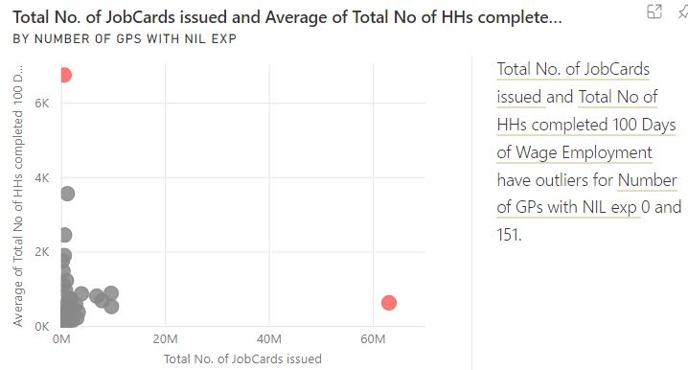
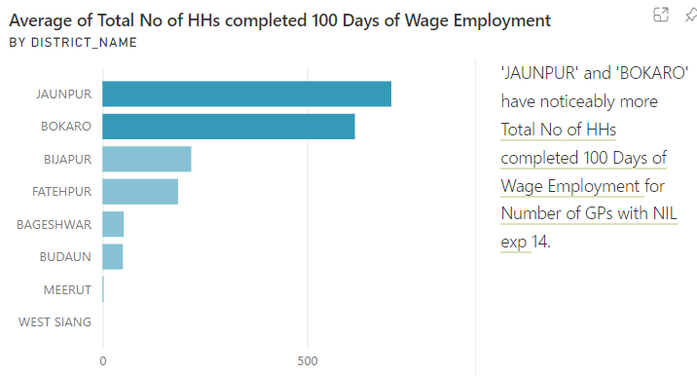

Slide 32
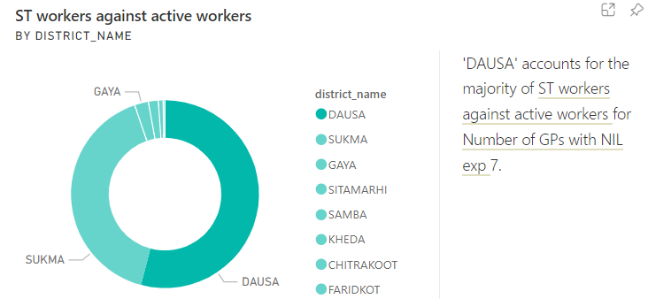
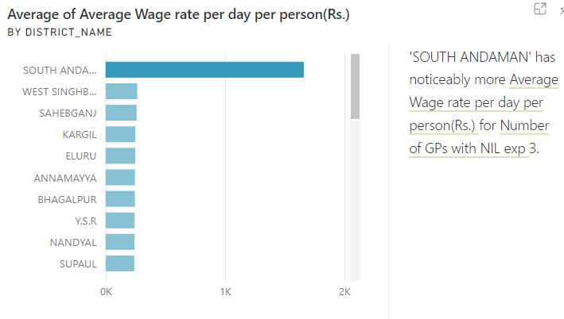

Slide 33
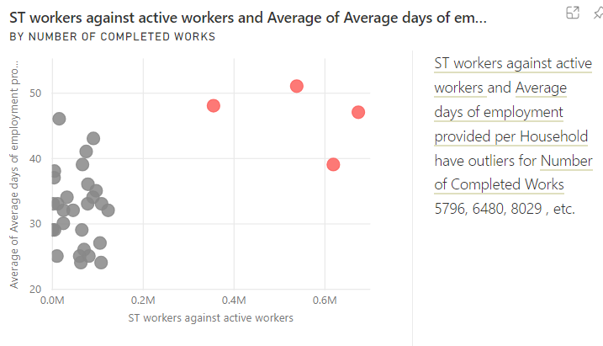
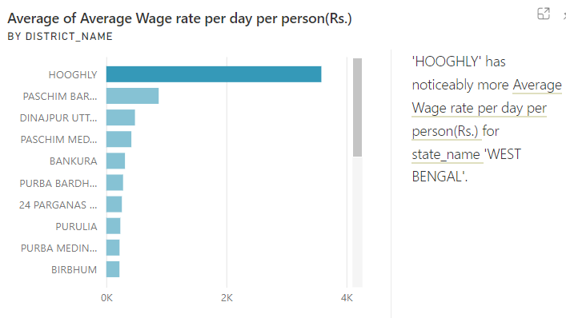

Slide 34
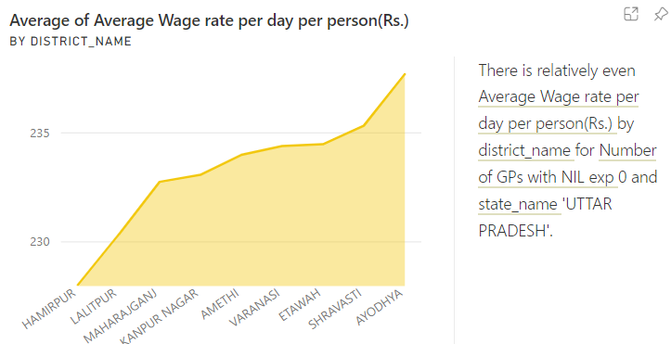
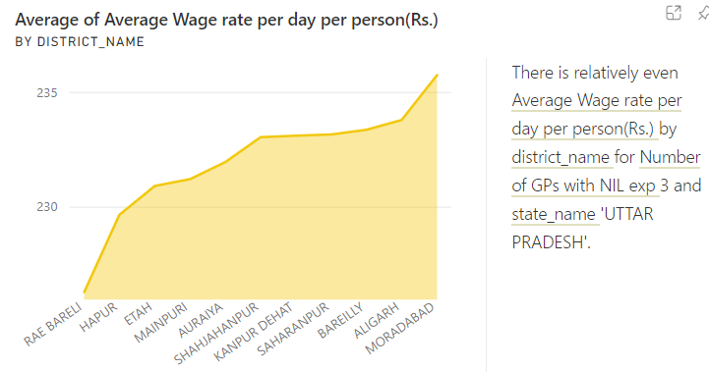

Slide 35
CONCLUSION
12
At 18430541, WEST BENGAL had the highest Sum of Total No. of Active Workers and was 92,15,26,950.00% higher than DN HAVELI AND DD, which had the lowest Sum of Total No. of Active Workers at 2.
﻿﻿﻿﻿﻿﻿﻿WEST BENGAL accounted for 10.50% of Sum of Total No. of Active Workers.﻿﻿﻿﻿﻿﻿
Across all 34 state_name, Sum of Total No. of Active Workers ranged from 2 to 18430541.
﻿﻿﻿﻿﻿﻿Sum of Approved Labour Budget and total Sum of Women Persondays are positively correlated with each other.﻿﻿﻿﻿﻿

Slide 36
THANK YOU

